Slide 1
Coding as classical scholarship
Katy Felkner
Advisor: Dr. Samuel Huskey, Classics and Letters
OU WiE First-Year Interest Group
November 29th, 2017

Slide 2
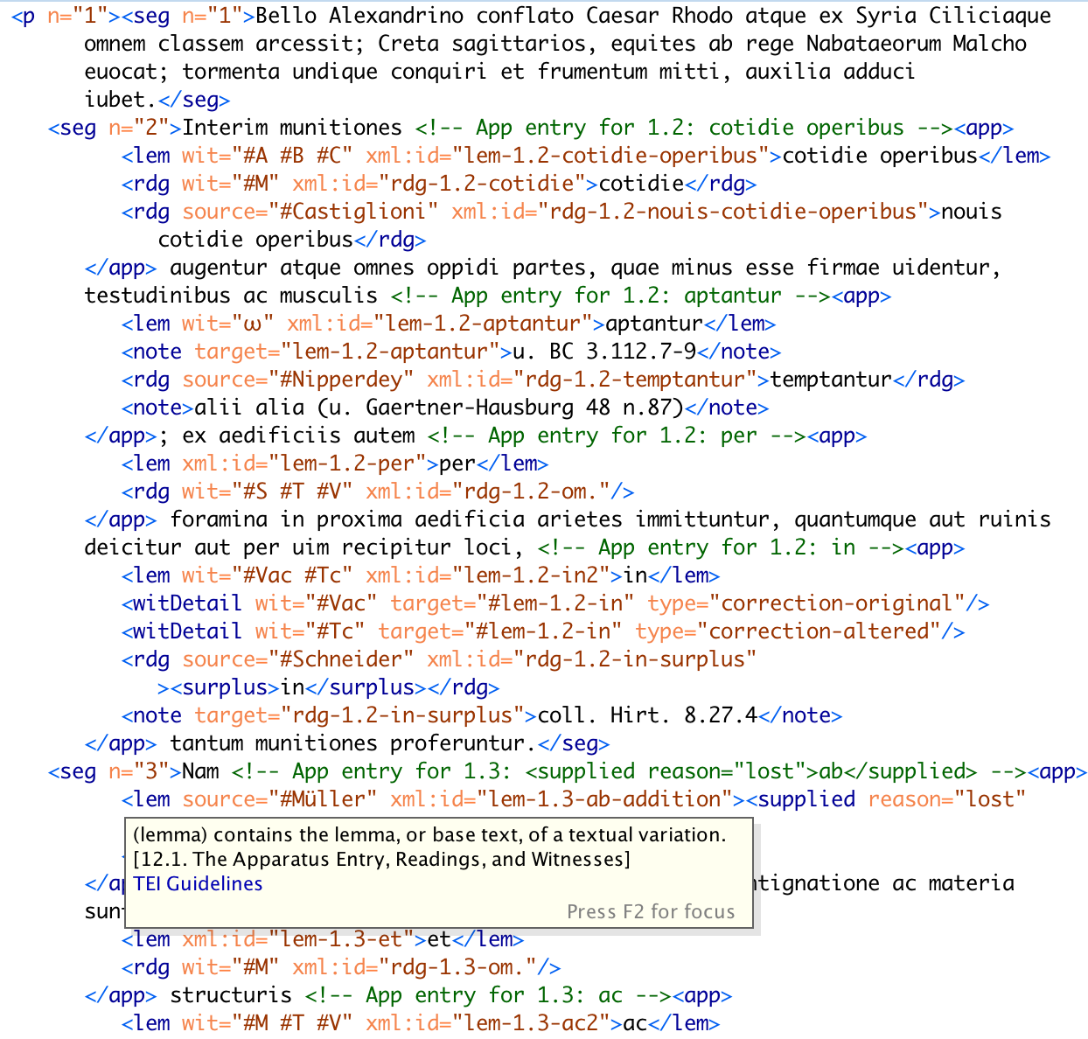
Notes:
First, explain what a critical edition is
Ancient texts come down to us via hand copied manuscripts, which contain lots of errors
The critical apparatus contains information about textual variants in different manuscripts
A traditional critical edition, which includes an edited version of an ancient text and possible alternate readings, is visually encoded data which is understandable by a person with relevant background. It is not machine readable.
XML is
An XML-encoded edition is a machine readable representation of the same textual data. It allows us to use computers to visualize, analyze, and better understand the text.
The goal of my project was to develop a software tool which automates this encoding in order to facilitate the creation of new digital critical editions.

Slide 3
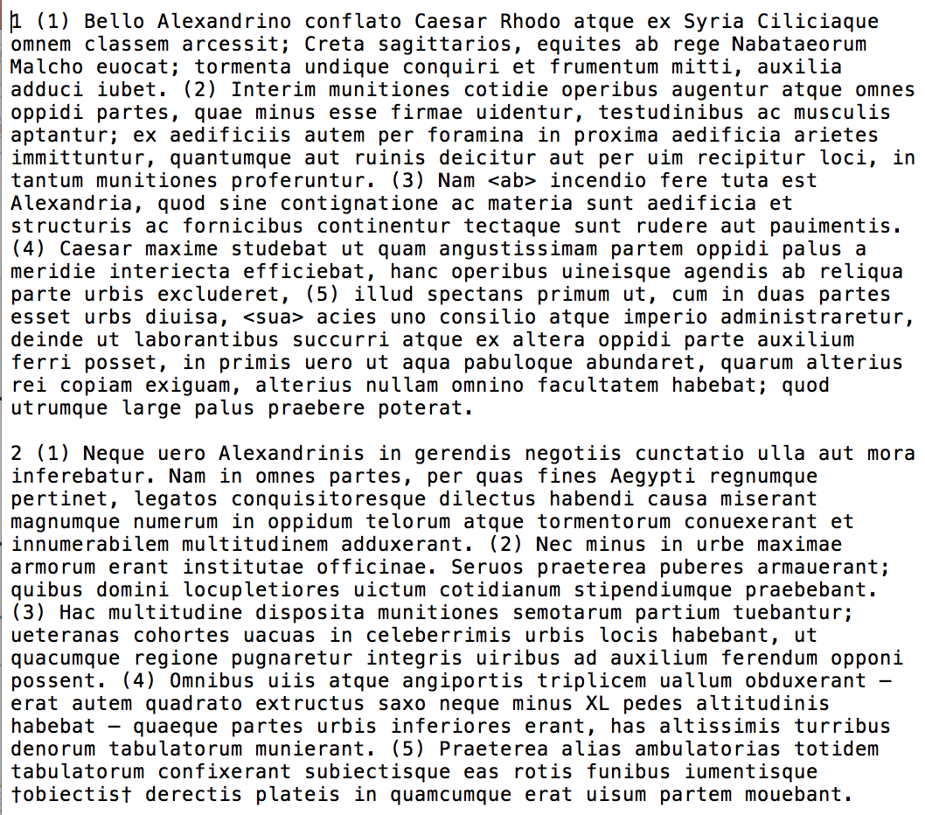
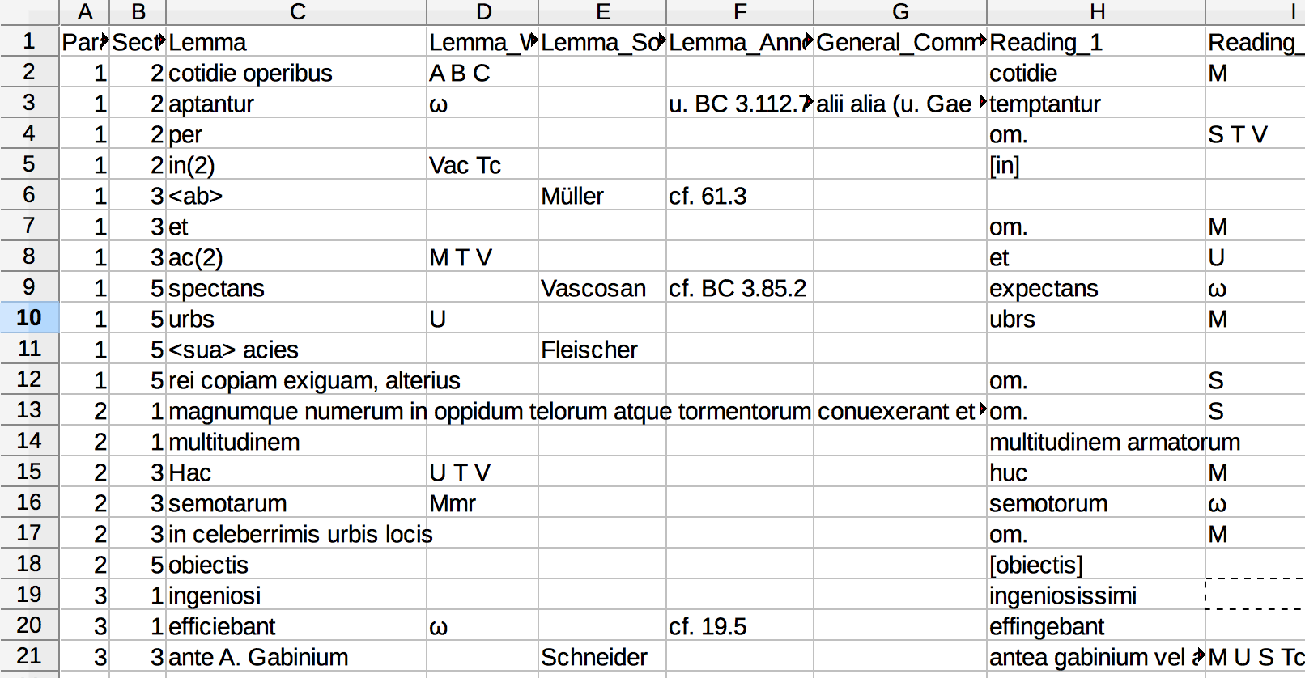
Notes:
In particular, I have developed a python script which automates the creation of a fully-encoded critical edition from a plain text file and a text CSV app crit.
On the left is a plain text version of Caesar’s Bellum Alexandrinum. It includes only the text itself, paragraph and section numbers, and very limited markup. Unlike the printed critical edition in the last slide, it does not include information about alternate readings or other critical data.
On the right is the critical apparatus. The actual input is a plain CSV (comma separated values) file but it is shown here as a spreadsheet for clarity.

Slide 4
Demo time!
Notes:
I’ll switch over to python and show my demo here!

Slide 5
Applications and Takeaways
Most classics faculty do not have coding background or the time to learn XML
My script allows them to produce XML encoded critical editions without having to code!
Data entry into the spreadsheet is not difficult and does not require coding knowledge.
I have developed guidelines for classics undergrads (with little to no technical background) at other universities to produce these spreadsheets from existing critical editions
Future research goals:
Processing poetry and drama as well as prose
Poetry script is written and currently in testing and debugging
Basic framework for the drama script is in place, but it is not yet operational
Notes:
Mention that Princeton undergrads are using my work
LDLT data is free and open source – people can do whatever they want with it
Also mention educational outcomes
Makes critical editions accessible to advanced high school and early undergraduate Latin students
Allows students to understand the texts they read in class more fully
Helps bridge the gap between textbooks and scholarly editions

